Slide 1
Rockbuster
Company Overview

Slide 2
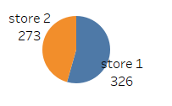
Rockbuster Company Profile
Two Stores
Nearly 600 customers across the globe

Slide 3
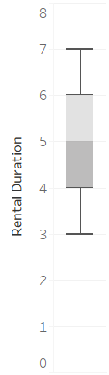
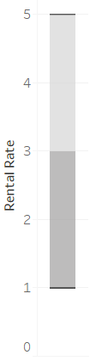
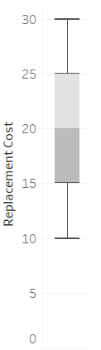
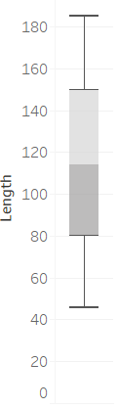
Product Overview
Rental range from 3 – 7 days
Three pricing structure
- 0.99, 2.99, 4.99
Replacement range 9.99 – 29.99
Min movie length 46 mins
Max movie length 185 minutes

Slide 4
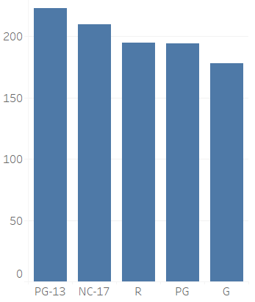
Product Overview
5 MPAA ratings
(PG-13, G, PG, NC-17, R)
Most popular rating – PG-13

Slide 5
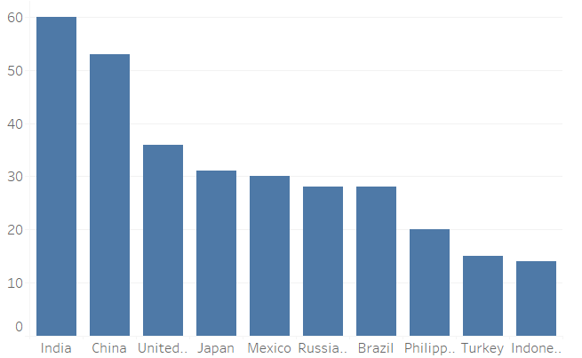
Rockbuster Customer demographics
Top 10 countries
-India
-China
-United States
-Japan
-Mexico
-Russian Federation
-Brazil
-Philippines
-Turkey
-Indonesia

Slide 6
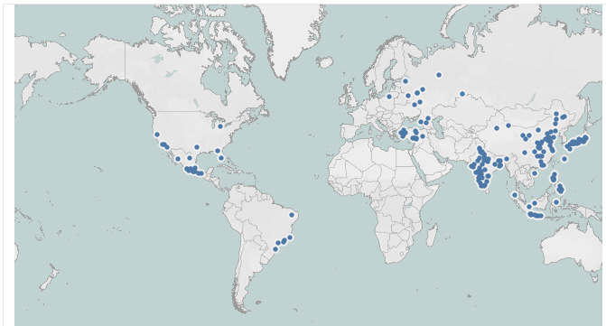
Rockbuster Customer demographics
Evenly distributed across multiple cities in within the Top 10 countries
https://public.tableau.com/app/profile/cheng.hee.liew/viz/Task3_10_RockbusterPresentation/Top5CustomerMap?publish=yes

Slide 7
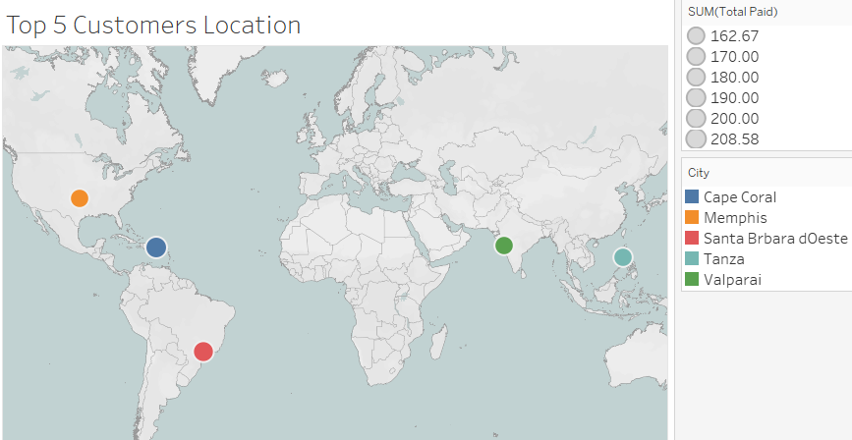
Rockbuster Customer demographics
Top 5 customers
- two from United States
- one from Brazi
- one from India
- one from Philippines
https://public.tableau.com/app/profile/cheng.hee.liew/viz/Task3_10_RockbusterPresentation/Top5CustomerMap?publish=yes

Slide 8
The End

